Slide 1

Micro-SAM
Adam Dare
20/06/2024

Slide 2



Overview
- SAM & Micro-SAM
-Handling TIFF Files
-Current Examples

Slide 3




Introduction
I was tasked with detecting and segmenting Nuclei and Cell membranes in Fluorescent Microscopy Images of Fruit Fly and Zebra Fish cells, using Micro-SAM.
This Presentation will demonstrate how I have started going about this and what Micro-SAM offers.

Slide 4
SAM & Micro-SAM
What is SAM & Micro-SAM
Segment Anything (SAM), developed by Meta AI, is a model that allows you to identify the location of different objects in the image.
Micro-SAM is built upon the Segment Anything by Meta AI to specialise in annotating 2D and 3D microscopy data. This model also facilitates tracking objects, such as cells, mitochondria or nuclei.
Micro-SAM enables you to interactively annotate the microscopy images through the Napari software. This software allows you to utilise and fine tune the models without any coding knowledge or experience.
Environment Requirements
To use Micro-SAM you need to download Conda’s Miniforge application and utilise Mamba to install various python libraries such as: PyTorch, Numpy, Matplotlib and Tiff File.
Notes:
They are still working upon:
More fine tuned models
Integrating parameter efficient training
Compressed models
Improved 3D segmentation & Tracking
Micro-SAM Environment:
Mini Forge
Requires Mamba to install the required libraries
PyTorch
Numpy, Matplotlib, TiffFile, Micro_SAM
-There are various models on offer:
vit_l_lm: A model for finetuned model for cells and Nuclei on light microscopy for ViT Large Backbone
vit_b_lm: A model for finetuned model for cells and Nuclei on light microscopy for ViT Backbone
vit_l_em_organelles: Fintuned for mitochondria & nuclei in electron microscopy

Slide 5
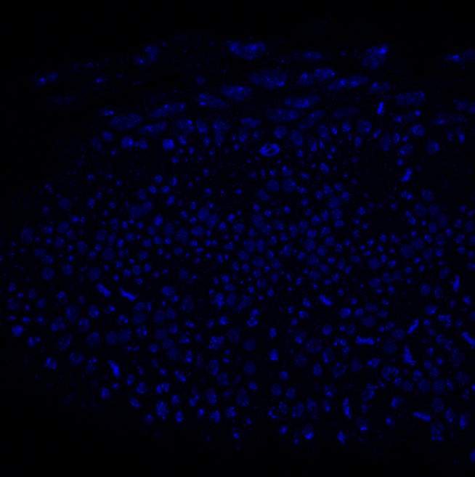
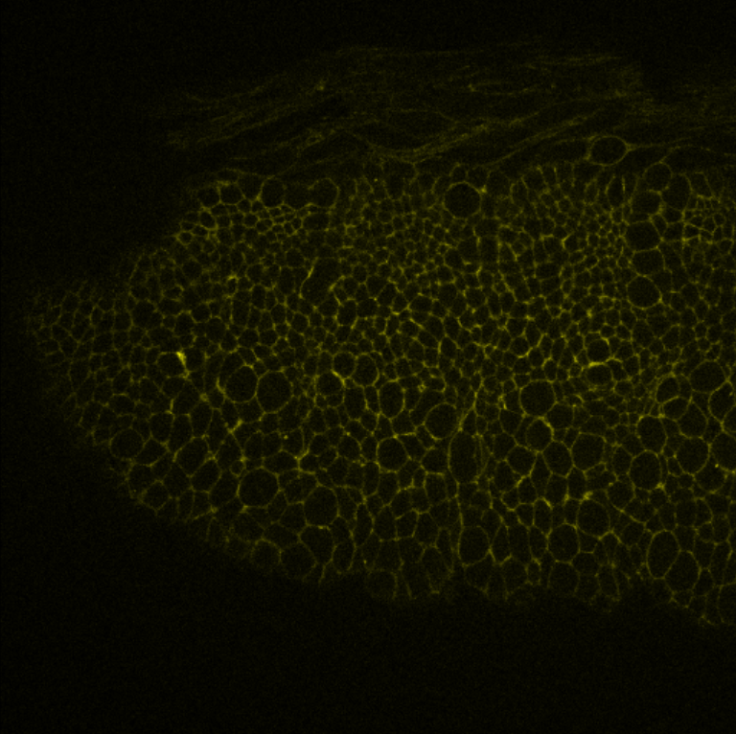
Handling Tiff Files
The Fruit Fly and Zebra Fish microscopy images were stored in TIFF Files and contained 4 separate channels. These images contained the nuclei and cell membranes of the respective animals.
To import these Tiff Files, you can use either python library tifffile or imageio and read these files in as NumPy arrays.
Once the files are read, each channel is extracted into separate arrays facilitating 2D Automatic Instance Segmentation. These arrays are iterated through to then extract a single frame from the Tiff File to then be passed to Micro-Sam’s Automatic Instance Segmentation method. The results for this are then stored and can be individually selected.
These results then need to be exported and stored.
Notes:
Show the code for extracting TIFF

Slide 6
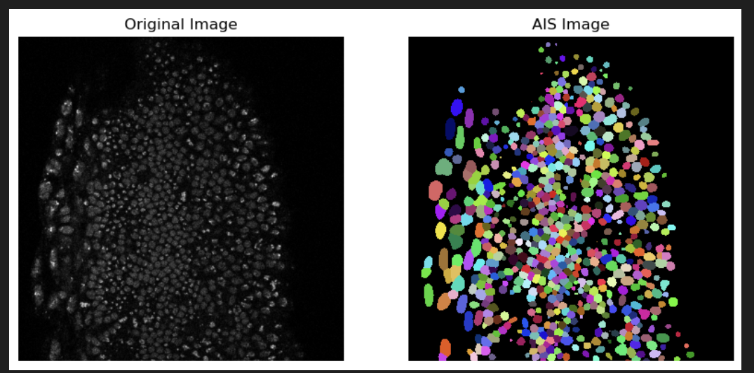
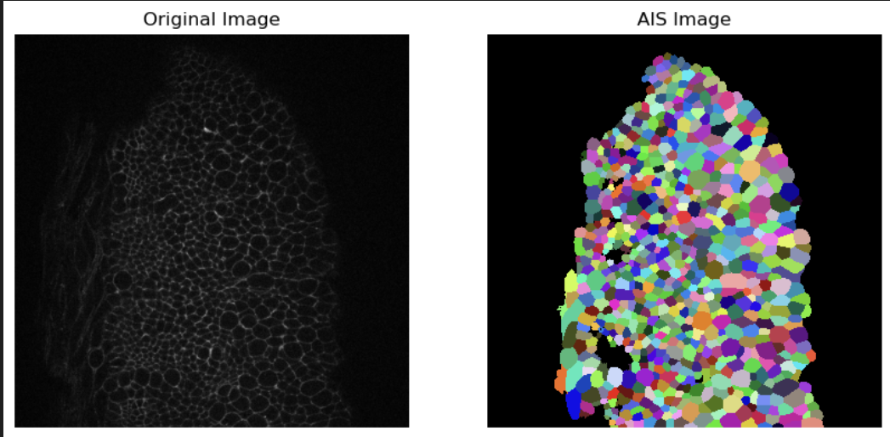
Current Examples
Channel 1
Channel 2
Segmenting Nuclei
Attempt at Segmenting Cell Membranes
Notes:
Show the code for extracting TIFF
Explain that the vl_l_lm model is meant for cells and nuclei so its great for the nucleus images not so much the cell membrane
I believe there is a way to adjust the segmentations though I will need to sort this out properly.

Slide 7

Summary
In conclusion Micro-SAM is great for annotating the Microscopy Images in both the 2D and 3D spaces.

Slide 8


Thank You
Adam Dare
ad1323@student.aru.ac.uk

Slide 9
References
https://computational-cell-analytics.github.io/micro-sam/micro_sam.html#finetuning-ui
https://github.com/computational-cell-analytics/micro-sam
https://www.youtube.com/playlist?list=PLwYZXQJ3f36GQPpKCrSbHjGiH39X4XjSO
https://medium.com/red-buffer/beyond-the-surface-advanced-3d-mesh-generation-from-2d-images-in-python-0de6dd3944ac
Notes:
Show the code for extracting TIFF

